Slide 1

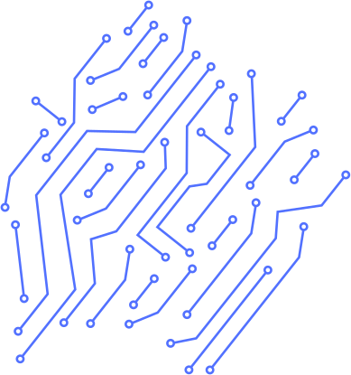


FACIAL RECOGNITION SYSTEM
TEAM
2

Slide 2

THYNK UNLIMITED
PROBLEM STATMENT
Face recognition systems are widely used in security, authentication, and smart applications.
However, raw face datasets usually contain challenges such as:
Variations in pose, lighting, and expression that reduce recognition accuracy.
Multiple faces in one image, making it unclear which one to use for training.
Unaligned and unstandardized images that lead to inconsistent feature extraction.
Noise and background clutter that affect model performance.
Without proper preprocessing, deep learning models (e.g., FaceNet, VGGFace) cannot achieve optimal accuracy or generalization.
Therefore, there is a need for an automated face data preparation pipeline that detects, aligns, crops, and standardizes faces to a fixed size (128×128), ensuring high-quality inputs for training.

Slide 3

THYNK UNLIMITED
PROJECT OVERVIEW
This project aims to build a Facial Recognition System that can reliably identify and authenticate individuals in real time, even under variations in lighting, pose, or expression.
The system is built using LFW dataset and deployed in a simple Streamlit web app.

Slide 4

THYNK UNLIMITED
PROJECT STATMINT
1
2
3
4
PHASE
PHASE
PHASE
PHASE
Data Preparation
EDA + Feature Building
Model Traning & Validation
Deployment via web interface
By : Mohamed Khaled Rammah
By : Ahmed Abdelkader & Ibrahim Mohamed
By : Mostafa Tarek & Mohamed Mamdouh
By : Nour Ezz

Slide 5

THYNK UNLIMITED
1
PHASE
Face Data Preparation
Goal: Convert raw images to high-quality 128x128 RGB uniform faces for training.
Steps:
Load & Decode: Safely read raw images and convert them from BGR → RGB.
Face Detection: Use MTCNN to detect faces + keypoints (eyes, mouth, etc.).
Face Selection: Select the largest face in the image if there is more than one.
Alignment: Adjust the face alignment using the eye line (calculate the tilt angle → rotate).
Cropping: Crop the face with a 20% margin around it (fallback to the normal box if there are no keypoints).
Resize: Resize the face to 128x128 (cv2.INTER_AREA).
Save: Save the processed images to ALIGNED_ROOT in JPEG format.
Visual QA: Display a comparison between the original and aligned images to ensure quality.
Functions:
align_and_crop() → Crops the face while taking the slant and margin into account.
process_image() → Executes the entire process from input to save (per image).

Slide 6
2
PHASE
EDA + Feature Building
EDA & Preprocessing:
Image inspection and dimensionality detection.
Resizing and normalization to standardize the input.
Label encoding and dataset preparation by splitting it into Train/Validation/Test.
Model Building:
CNN design containing Convolution, Pooling, Dropout, and Dense layers.
Using ReLU as activation and Softmax for the output.
Optimizer: Adam with categorical cross-entropy loss function.
Training & Evaluation:
Monitoring accuracy and loss curves to avoid overfitting.
Performance measurement using Accuracy, Precision, Recall, F1-score, and Confusion Matrix.
Results:
The model achieved good accuracy in face recognition.
Future improvements may include data augmentation, augmentation, and fine-tuning.

Slide 7
2
PHASE
EDA + Feature Building
Data Augmentation:
1- Imports: Import the necessary libraries. matplotlib is used for displaying images, numpy is for handling arrays and image data, os is for accessing files and directories, random is for randomly selecting folders or images, and tensorflow/keras provides the tools for image preprocessing and augmentation.
2- plotImages function: A helper function that takes a list of images and displays them side by side in one row (10 images). It hides the axes to make the visualization cleaner and ensures all images are shown clearly without overlap.
3- ImageDataGenerator: Creates a generator that defines how images will be randomly augmented. This includes random rotations, shifts (horizontal and vertical), shear transformations, zooming, color shifts, and horizontal flips. The purpose is to generate new variations of existing images for training.
4- Pick random image: The code selects one random person folder from the dataset, then picks one random image inside that folder. Finally, it prints out the chosen person’s name and the full path of the chosen image.
5- Load image: The chosen image is read into a NumPy array, then expanded with an extra batch dimension (since generators expect batches). The original image is also displayed to confirm the selection.

Slide 8
2
PHASE
EDA + Feature Building
Data Augmentation:
6- Augment in memory: A generator is created using gen.flow(image). It produces augmented versions of the input image. In this case, 10 augmented images are generated and stored in a list. These are then displayed side by side using the plotImages function to visualize the results.
7- Prepare save folder: A new directory is created under augmented/<person>/ to store augmented images. If the folder already exists, it is reused without error. This ensures each person has their own folder for augmented images.
8- Augment + save: Another generator is created with the same augmentation settings, but this time it is configured to also save the generated images to disk. Each saved image will have a prefix "aug-image-" and will be stored in JPEG format inside the prepared folder.
9- Print save path: Finally, the code prints the absolute path of the save directory so you know exactly where the augmented images are being written on your computer.
.

Slide 9

3
PHASE
THYNK UNLIMITED
Model Traning & Validation
Bad Model (our first approach)
Objective:
Multi-class facial recognition for 5,749 individuals
Dataset: Labeled Faces in the Wild (LFW) - 12,161 total images
Model Type: Convolutional Neural Network (CNN)
Technical Stack:
TensorFlow/Keras for deep learning
OpenCV for image preprocessing
ImageDataGenerator for data pipeline
Critical Issue:
Data Imbalance, which is The Root Cause of Poor Accuracy
5,749 classes (individuals) but only 12,161 total images
Average: ~2.1 images per person around 4000 only have 1 image
Immediate Actions:
Stop training - continuing won't improve results significantly
Address the fundamental data imbalance issue
change your solution (which we did)

Slide 10
3
PHASE
THYNK UNLIMITED
Model Traning & Validation
Good Model
We tried a slightly different approach: we store the dimensions and faces of the people and work with something called nearest-neighbor.
1. We extract an embedding for each face image (using the face_recognition/dlib library).
2. We save all the embeddings and labels in the face_embeddings.pkl file.
3. At runtime (test/camera), we extract an embedding for the new image and measure the distance (Euclidean) for all the saved embeddings.
4. We select the nearest one (min distance). If the distance is less than the tolerance, we name it an identifier (person's name), otherwise we say it's unknown.
This isn't training, in the sense of training a new model (there's no backprop or optimization on the classifier). It's an identification system plus a simple verification feature using nearest-neighbor.

Slide 11
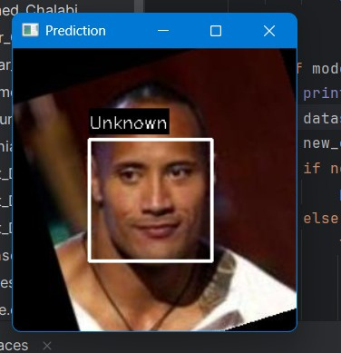
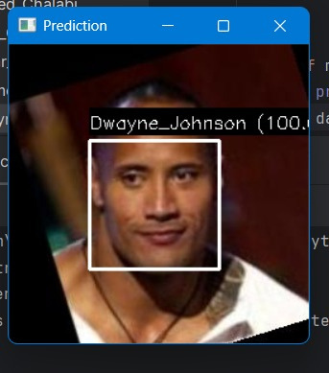

MODEL
BEFORE
AFTER
THYNK UNLIMITED

Slide 12
4
PHASE
Deployment via Streamlit interface
Main Features:
Upload & camera support
Confidence percentage shown
History log with timestamp
Adjustable confidence threshold
Results:
Successfully verifies enrolled faces with high accuracy
Provides clear feedback with confidence percentage
Stores verification history with timestamp
Simple and user friendly web interface
THYNK UNLIMITED

Slide 13
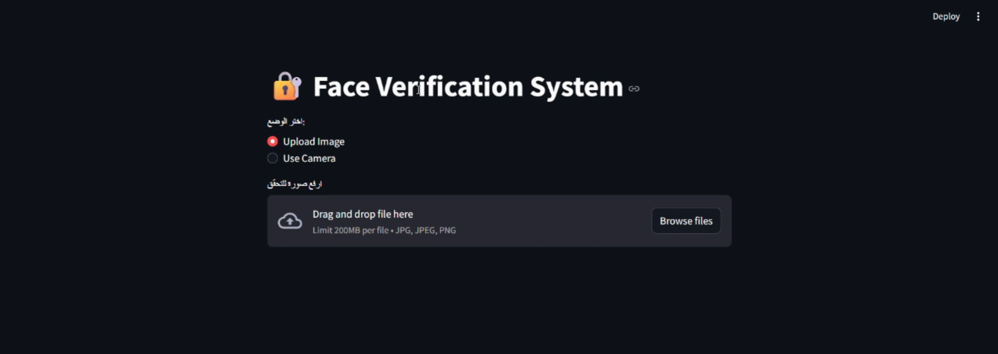
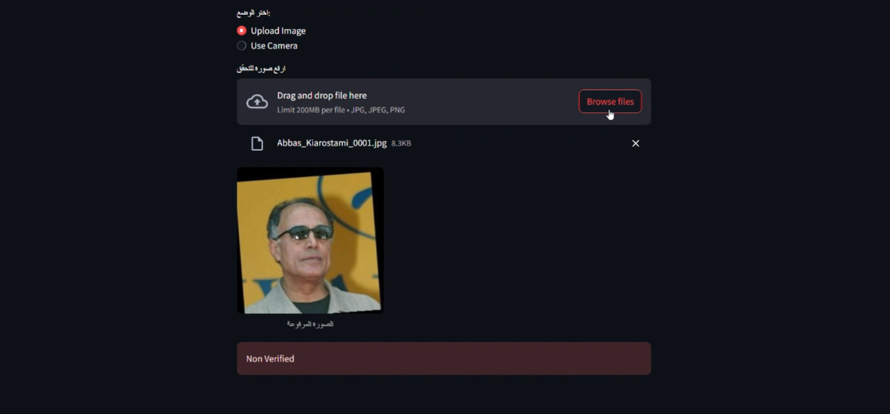
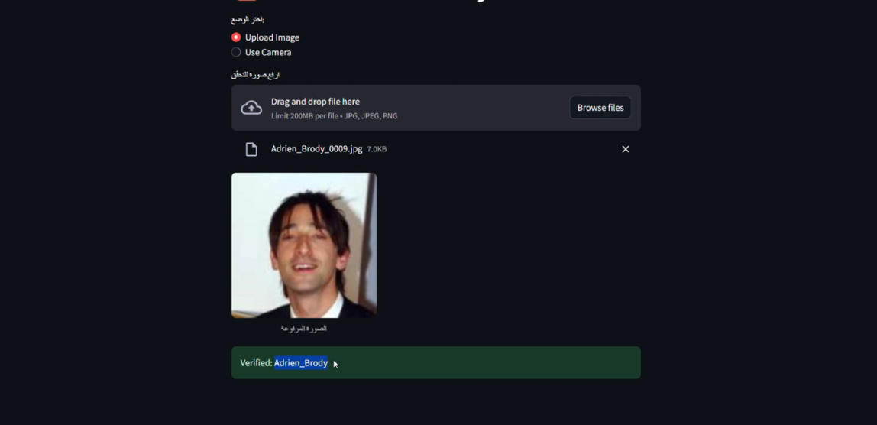
INTERFACE
THYNK UNLIMITED

Slide 14

TEAM WORK
1ST PHASE : DATA PREPARATION
MOHAMED KHALED : WORKED ON DATA DETECTION,ALIGNMENT AND CROPING
1
2
2nd phase : data visualization
Ahmed Abdelkader : worked on EDA
Ibrahim Mohamed : worked on data agumentation
3RD PHASE : MODEL TRANING & VALIDATION
MOSTAFA TAREK ; MADE THE FIRST APPROACH IN THE MODEL TRAINING USING CNN
MOHAMED MAMDOUH: MADE THE SECOND AND THE LAST APPROACH USING FACE EMBEDDINGS
4TH PHASE : DEPLOYMENT
NOUR EZZ : WORKED ON DEPLOYING THE PROJECT VIA WEBSITE
3
4

Slide 15

THYNK UNLIMITED
THANK YOU

